Slide 1
Project on OPP
Topics: Student Profile With All Semester Result
Management system
By Mahmudul Islam
Roll: 1607052
Dprt: CSE. KUET

Slide 2
Properties of The Project
We can do such thing through my project:--
We have to admit students.
We can view all Student.
We can edit Student profile.
We can cancel admission.
We can see student profile whit subject wise GP, whole GPA and CGPA.
We can update result after complete any course.
We can see rank of the student by CGPA.
We can see published result

Slide 3
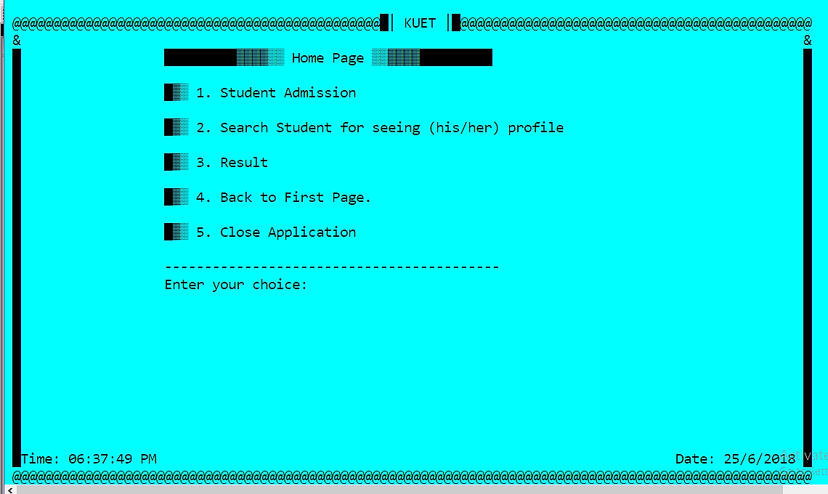
Content of Project

Slide 4
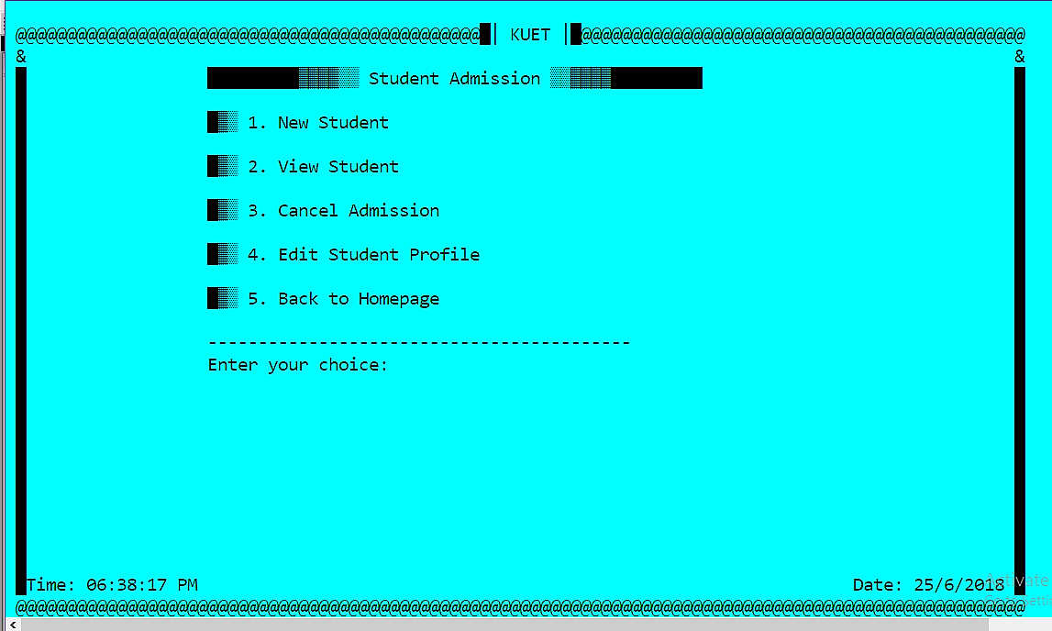
Content of Project

Slide 5
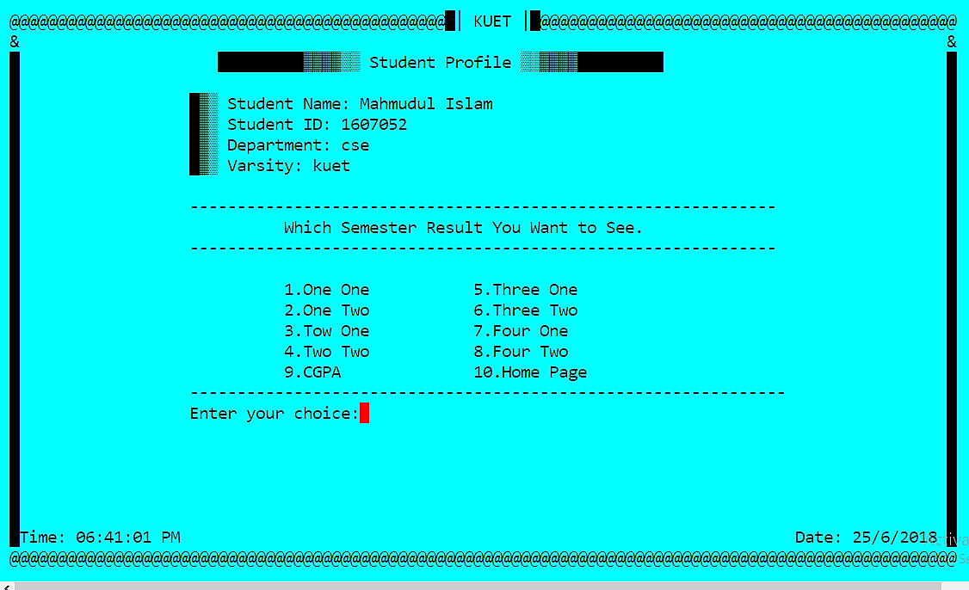
Content of Project

Slide 6
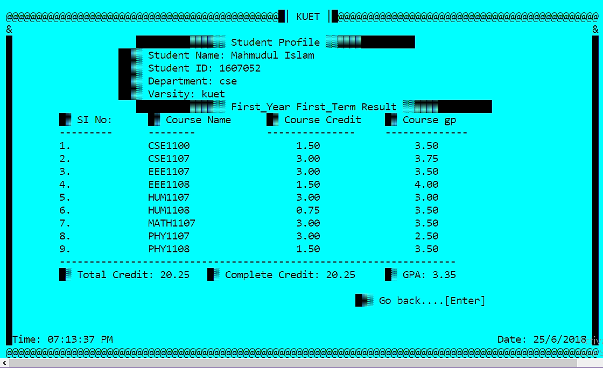
Content of Project

Slide 7
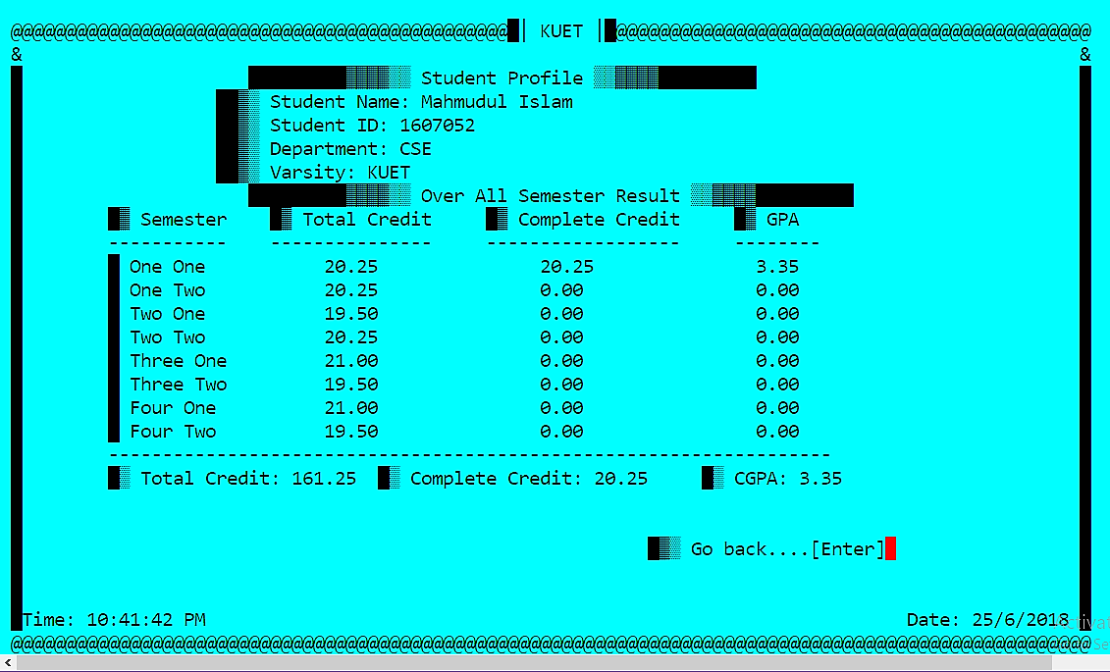
Content of Project

Slide 8
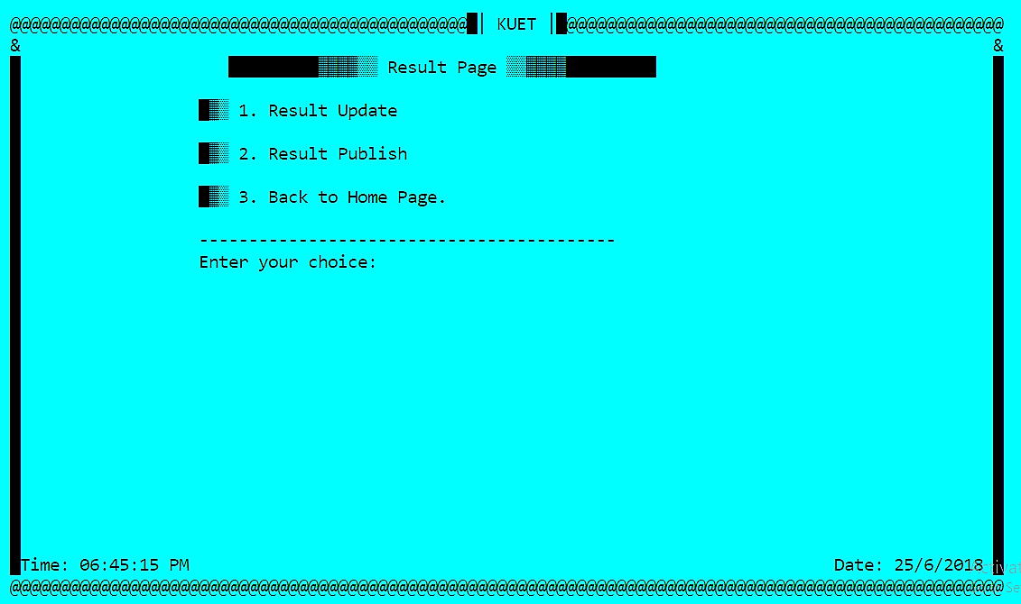
Content of Project

Slide 9
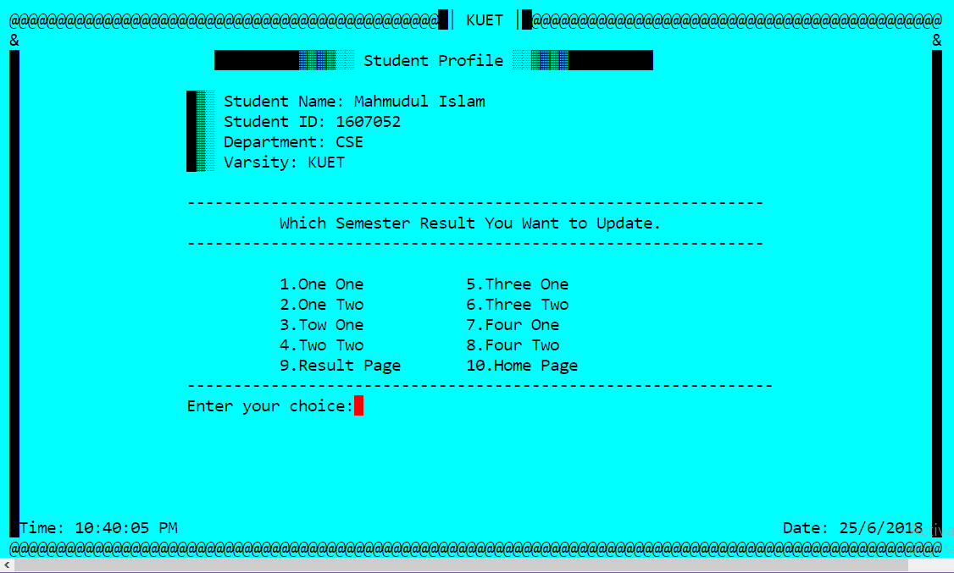
Content of Project

Slide 10
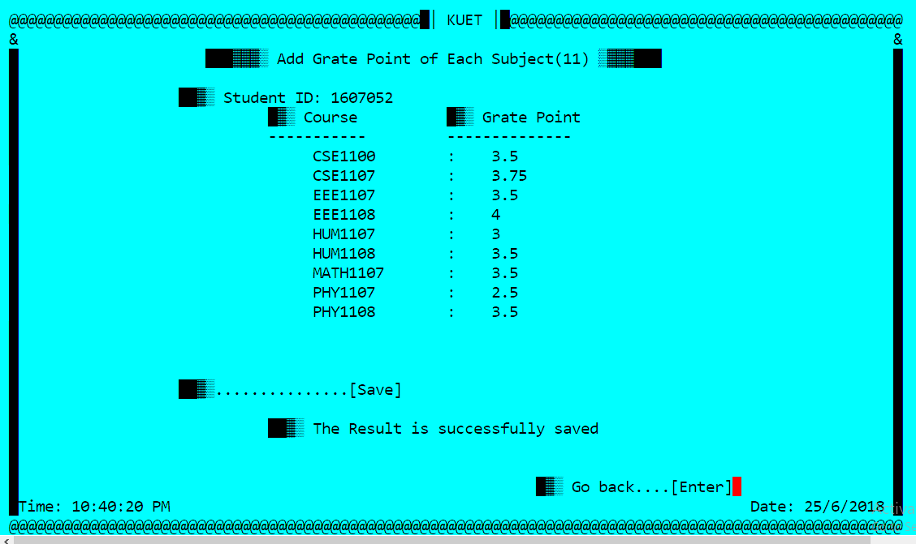
Content of Project

Slide 11
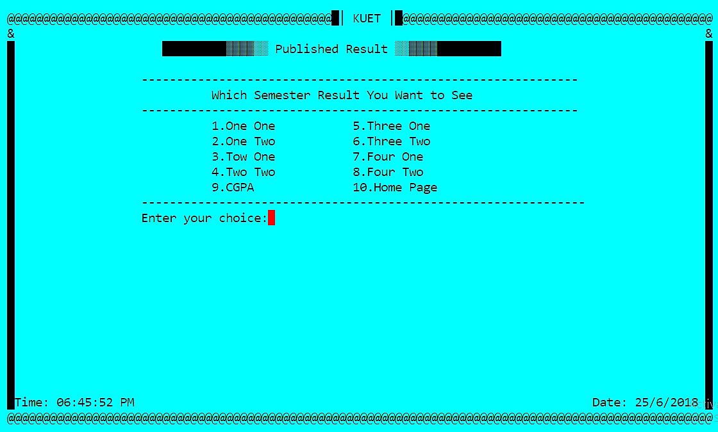
Content of Project

Slide 12
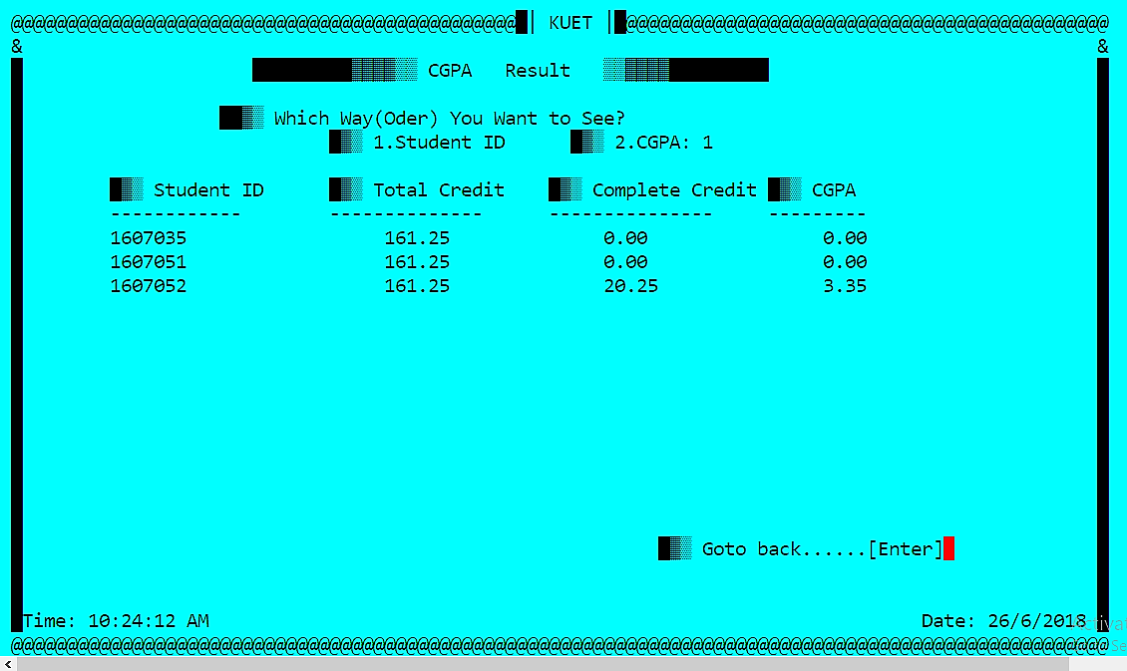
Content of Project

Slide 13
Feature of OOP which Use in Project
Namespace
Formation input output
File(I use binary mode)
Class & object
Constructor & Destructor
Inheritance
Polymorphism

Slide 14
Feature of OOP that Use in Project
Operator Overloding
Friend function
Virtual Function
Dynamic memory allocation
Functor
Template
STL

Slide 15

That’s All
Thank You

